Slide 1
CSC-40040 Talk 3 – MSc Project Posters
DR Mark Turner

Slide 2
The Project Poster
The first piece of summative assessment for CSC-40040 requires you to produce a poster describing your project.
There will be a poster day, when the posters will be displayed in the department and you will be expected to discuss your poster with staff and other students.
Poster session generally takes around two hours (and is a lot more fun than it sounds).
Note that this does not involve standing up and giving an oral presentation! You will stand next to your poster and answer questions conversationally on a one-to-one basis.

Slide 3
The Project Poster
The whole poster session is fairly informal.
a good motivational boost to your project.
the feedback you will receive from attendees and participants should set you on your way to producing your final project report.
We normally display examples of good posters around the department throughout the year, so you are encouraged to study these as a source of possible inspiration.

Slide 4
The Project Poster - Assessment
Poster will be marked out of 100%
But will be weighted to contribute 10% to the overall assessment of the CSC-40040 Project.
Detailed highly prescriptive marking schemes (as with Projects in general) are not desirable/possible for the posters.
However, all good posters should address themselves to three key aspects of a Computing project …

Slide 5
The Project Poster - Assessment
Background/Context to the project.
Including clearly stating your aims and objectives.
Evidence of what has been achieved so far and current work in progress.
What still needs to be done.
Evidence of effective and on-going project management.
Gantt Chart to show the time plan.
How you aim to use the remaining time to complete your project.

Slide 6
The Project Poster - Content
The content of your poster is similar to that of the project plan, but it will have far fewer words.
And be updated with the work since your Project Plan.
You are not expected to have finished your project work by the time of the poster, it is intended to be a visual summary of the current state of your project.
However, you should have some evidence of progressing since your project plan.
Screenshots, code snippets, data examples, initial findings, tables, etc.

Slide 7
The Project Poster - Content
Intended as a visual summary of the state of your project:
what the project is about,
why it is important,
how you have gone about doing it (methodology etc),
what you have done so far, and
what you have yet to do.

Slide 8
Poster Content
Possible sections to include on a poster:
title of project; student name; supervisor name.
project description; aims and objectives.
list of requirements and/or brief list of relevant background literature.
discussion of experiments/methodology.
sample of experimental data, questionnaires, card sorts, etc.
sample of annotated code or tabulated raw data or other results.
Screenshots of what you have designed/produced.
what has been achieved and what is yet to be done.
project plan in the form of a Gantt chart.

Slide 9
The Project Poster - Content
There should be some substance to your poster
not just all pictures.
However, the balance between saying too much and not saying enough is difficult.
You want it to be descriptive while still readable and eye catching.
Pictures/screenshots etc. are good to include alongside text.
Your supervisor will be able to advise on this.

Slide 10
Poster Layout
Your poster should be A1 in size.
PowerPoint is good for poster design, but you may use any application capable of generating the required output.
We require you to submit an electronic copy of your poster in PDF format.
Submission of the electronic copy of the poster is subject to usual School and University submission rules regarding plagiarism, late submissions and exceptional circumstances.

Slide 11
Poster Layout – Important Info
DO NOT use any form of the Keele University logo on your poster!
As the posters are only for the assessment for this module, this allows you more freedom in your design.
This is a change for the last few years:
posters you see on display may have the Keele logo,
This has changed recently and you MUST NOT include any version of the Keele University logo.

Slide 12
Poster Layout - Important Info
DO NOT use any form of the Keele University logo on your poster.
Also be very wary of using any other trademarked or copyrighted logos without permission.

Slide 13
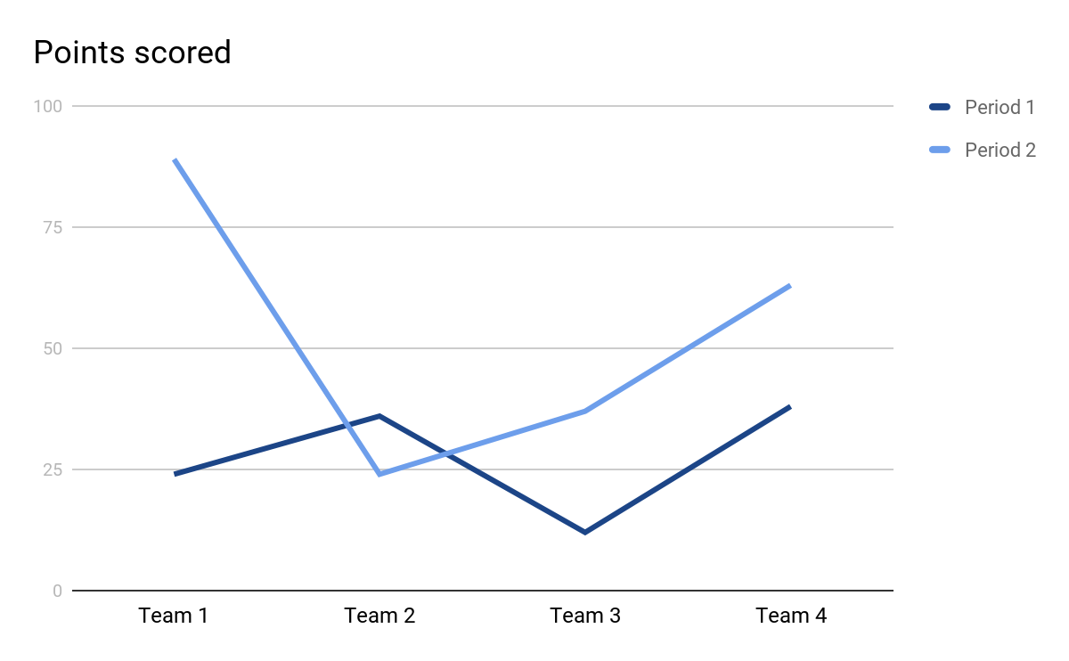
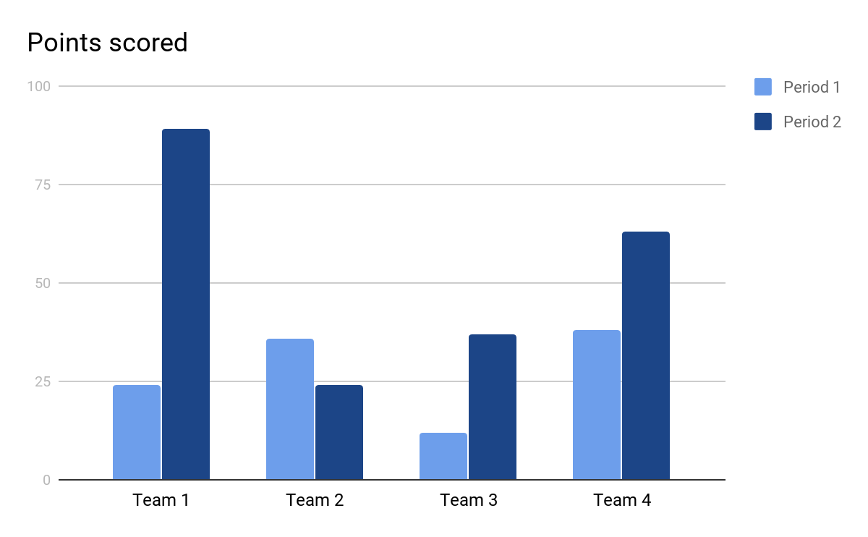
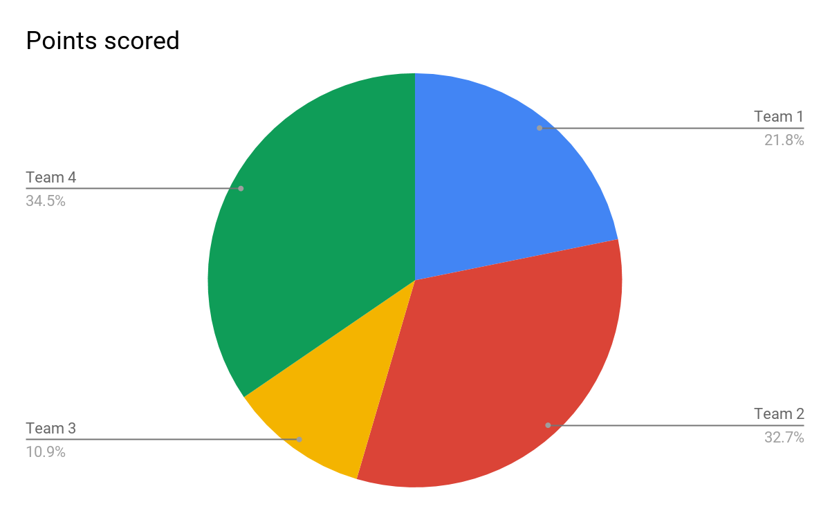
Poster Layout
Think about how your poster communicates visually
A1 poster size (pdf format)
Attracts & holds attention
Aesthetically pleasing
Colour will draw attention to areas of the poster
Serves as an illustrated abstract
Should be large enough to read from 1 to 2 metres
Create an uncluttered design to emphasise the subject matter
Straightforward organisation or flow
Engaging Main Title
Author's name, contact details and organisation details
Introduction
Methods
Results
Discussion
Conclusion
References

Slide 14
Poster Layout
Evaluate using ‘60 second rule’
Overall appearance
White space
Text / graphic balance
Text size
Organisation & flow
Author identification
Research/Project objective(s)
Main points
Summary/conclusion
References ??
Consider the proportions
~40-50% text
> 30-40% graphics
< 20% white space
Balance margins & white space
Avoid crowding content
“Less can be more” & “Keep it Simple”
“A picture is worth 1000 words”

Slide 15
Poster Submission
Poster Session
Camera-ready poster-printing and assessment deadline
Electronic submission - pdf format
1pm, Wednesday 30/07/25
pdf copies uploaded to the KLE drop-box by this date/time will be printed by SCM (at the School’s expense!)
why do we want the posters printed … ?

Slide 16

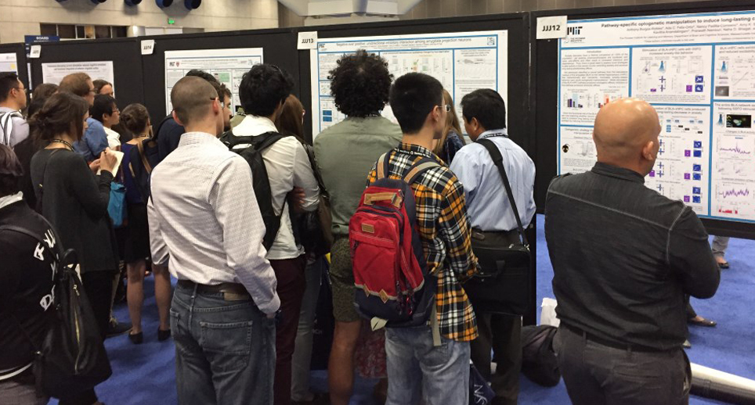

CSC-30014/CSC-40052 Computing Poster Session
Poster Session
Wednesday 13/08/25 in CR114 & Colin Reeves first-floor corridor from 2-4pm
No marking/assessment during poster session!

Slide 17
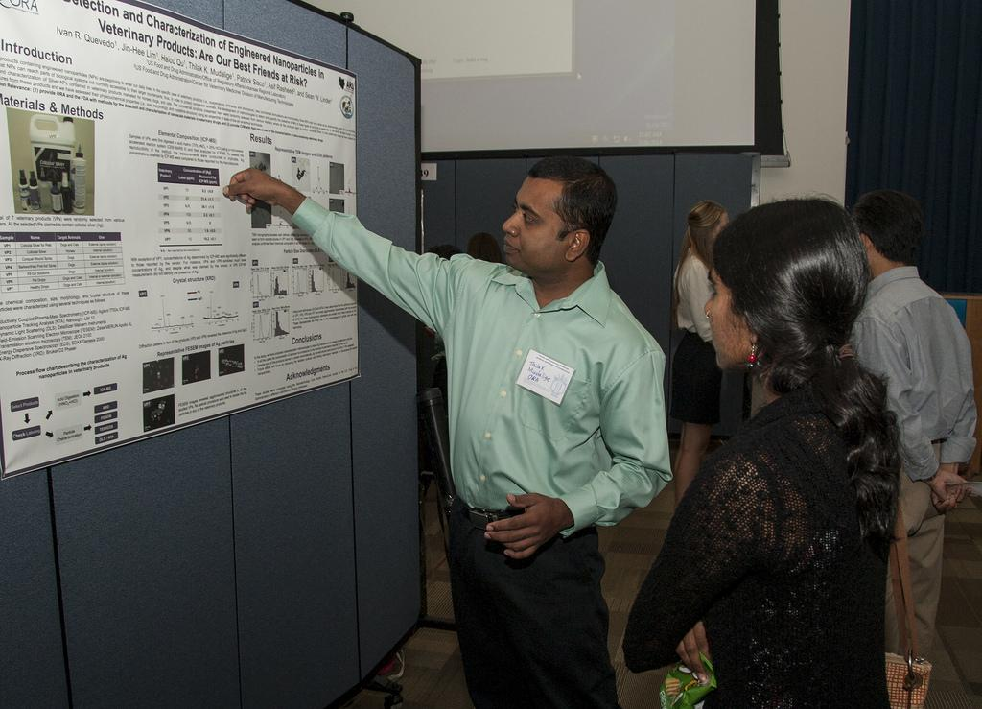
Poster Session
Consider the main take home message(s).
Key points you wish to draw your audience to.
Is there any additional information you can add during a conversation.
No marking during poster session
nothing that takes place during the Computing poster session is being marked/assessed

Slide 18
Poster Marking
Poster mark makes up 10% of the overall project mark.
Your poster will be marked independently by two members of academic staff.
Final poster mark usually being approximately midway between their assessments.
Marked purely on your poster separately from the poster session.
Further information can be found in the Project Handbook.

Slide 19
Posters – Important Dates
Submission of PDF files of your posters to the KLE dropbox:
1pm Wednesday 30th July 2025
For posters to be printed ready for the poster session
Poster Session:
2pm, Wednesday 13th August 2025
Upstairs in the Colin Reeves (Computer Science) building, in CR114 and in the corridor outside.

Slide 20
Outstanding submissions
Project Plans and GDPR/Ethics checklists
If you have not submitted your Project Plan and GDPR/Ethics checklists yet
Do so as soon as possible.
MUST be included in the appendices of your final report.
Ethical Review Application Form (ERA)
If you have ticked ‘Yes’ to the question regarding the use of human data on the GDPR/Ethics checklist then you need to submit an Ethical Review Application form.
There are lecture slides on the Assessment dropbox for the Ethical Review Application form that explain more about the form.

